Slide 1
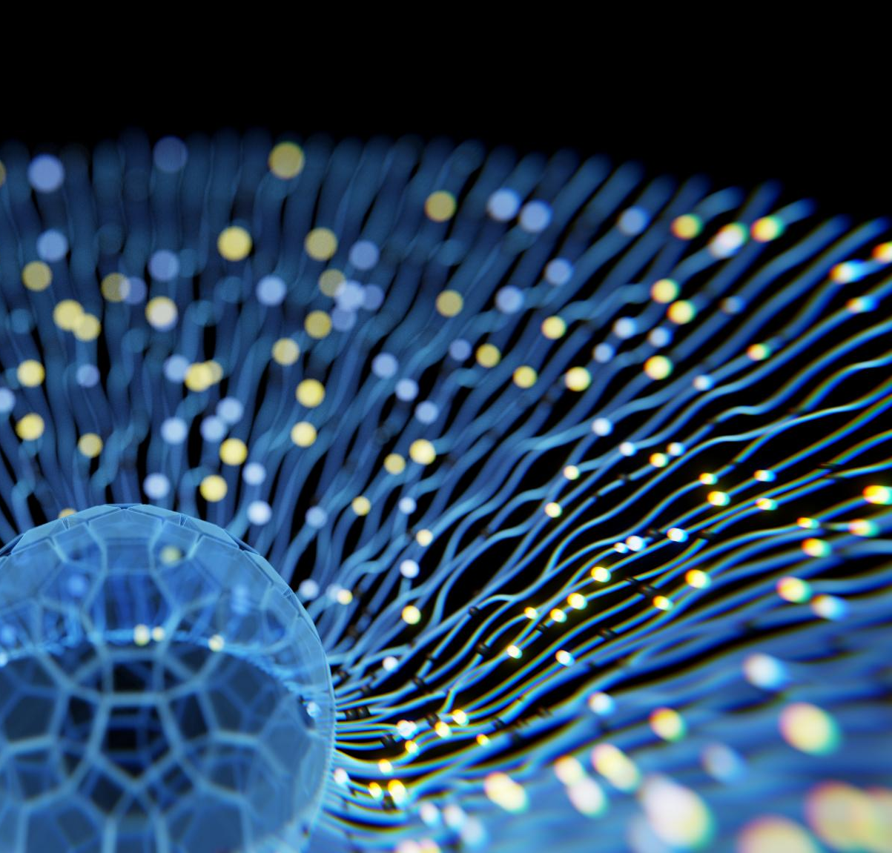
Deep Learning-Based Super-Resolution Techniques for 3D MRI Reconstruction
Enhancing medical images using advanced AI methods
Date: 19-12-2025
N. Manivasagan, Presidency University
Dr. D. Sivabalaselvamani, Associate Professor,
Presidency University, Bangalore
Notes:
AI-generated content may be incorrect. ---

Slide 2
Introduction and Context
Notes:
--- This slide references information from the following file: https://pwc-my.sharepoint.com/personal/manivasagan_n_pwc_com/_layouts/15/Doc.aspx?sourcedoc=%7BA6E83C66-E955-4155-ABE9-45936D13C444%7D&file=MANIVASAGAN%20-surveypaper-Final%20copy%20-%20Copy.docx&action=default&mobileredirect=true Overview of MRI and Challenges, Purpose and Scope of the Survey

Slide 3
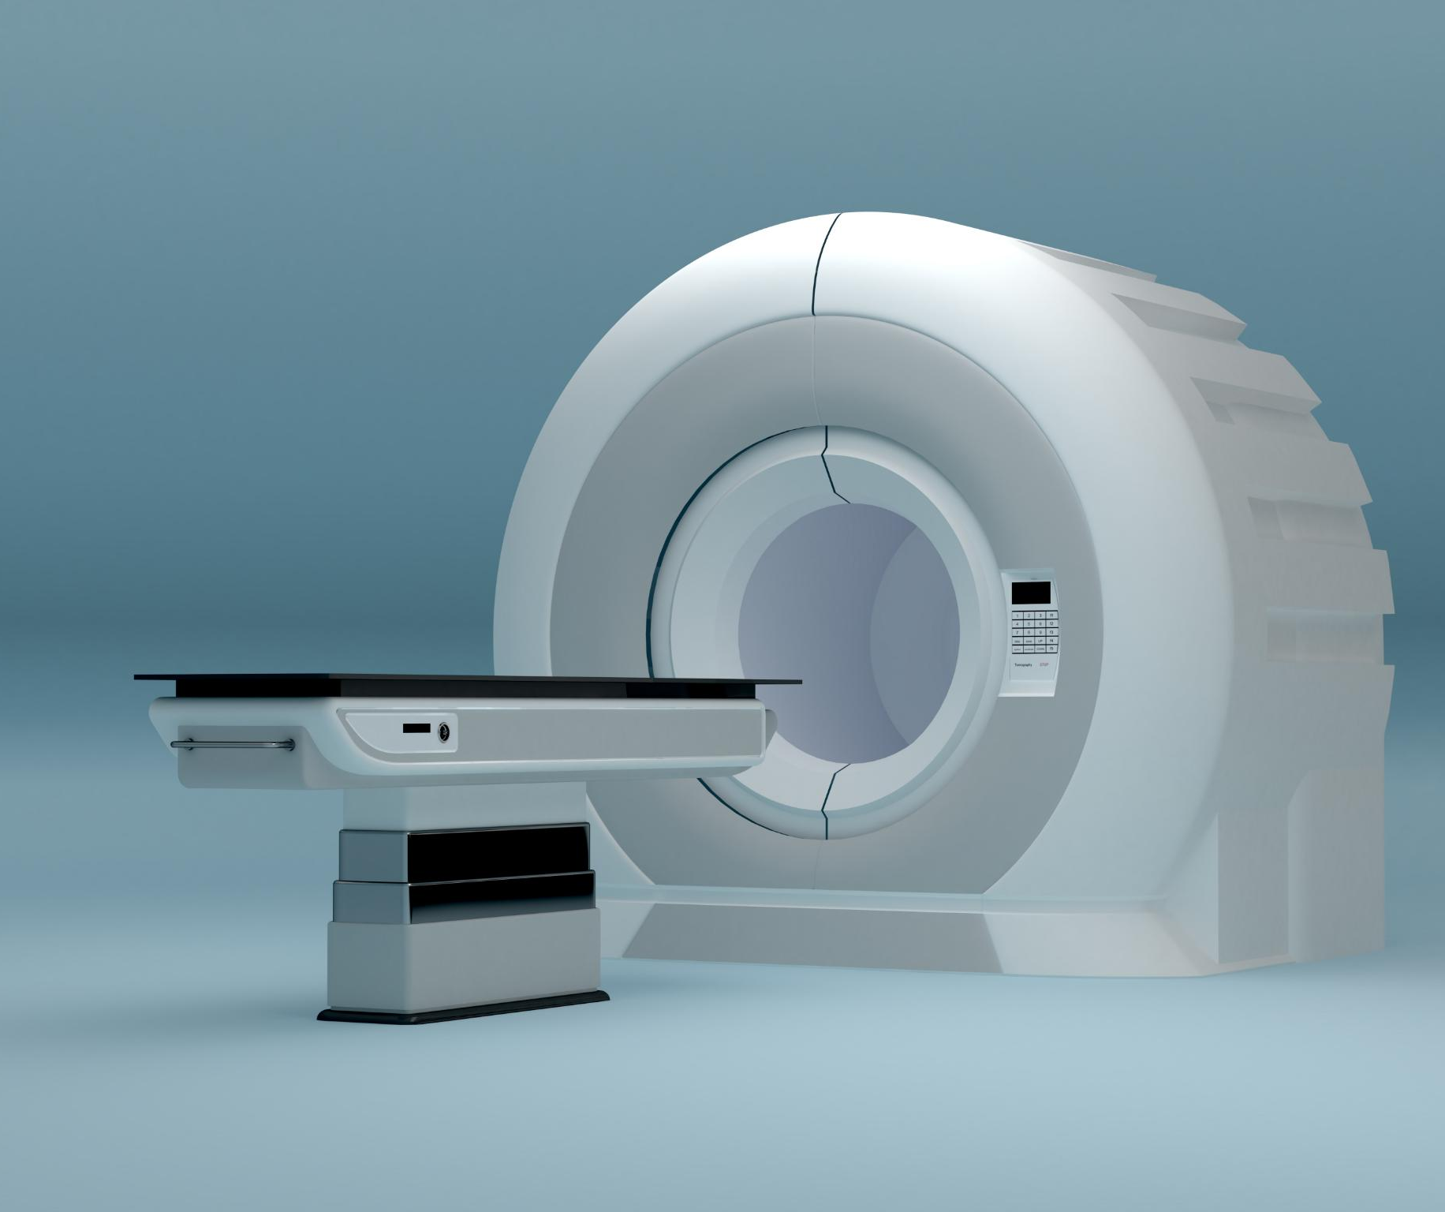
Overview of MRI and Challenges
MRI Diagnostic Importance
MRI provides non-invasive, high contrast imaging crucial for neurological, cardiovascular, and musculoskeletal diagnosis.
Challenges in MRI
MRI faces challenges like low spatial resolution, long scan times, and motion artifacts affecting image quality.
Limitations of Conventional Methods
Traditional interpolation and reconstruction methods fail to preserve fine anatomical details in MRI images.
Deep Learning Super-Resolution
Deep learning-based super-resolution enhances MRI image quality without extra scanning time or hardware changes.
Notes:
--- This slide references information from the following file: https://pwc-my.sharepoint.com/personal/manivasagan_n_pwc_com/_layouts/15/Doc.aspx?sourcedoc=%7BA6E83C66-E955-4155-ABE9-45936D13C444%7D&file=MANIVASAGAN%20-surveypaper-Final%20copy%20-%20Copy.docx&action=default&mobileredirect=true Magnetic Resonance Imaging (MRI) is a cornerstone in medical diagnostics due to its non-invasive nature and superior soft-tissue contrast. It plays a critical role in detecting neurological, cardiovascular, and musculoskeletal disorders. However, MRI faces significant challenges such as low spatial resolution, long acquisition times, and susceptibility to motion artifacts. These limitations often lead to patient discomfort and reduced clinical throughput. Conventional methods like interpolation and reconstruction-based approaches have attempted to address these issues but fall short in preserving fine anatomical details. This sets the stage for advanced computational techniques, particularly deep learning-based super-resolution (SR), which can enhance image quality without additional scanning time or hardware modifications. SR techniques aim to reconstruct high-resolution images from low-resolution inputs, improving diagnostic accuracy and workflow efficiency.

Slide 4
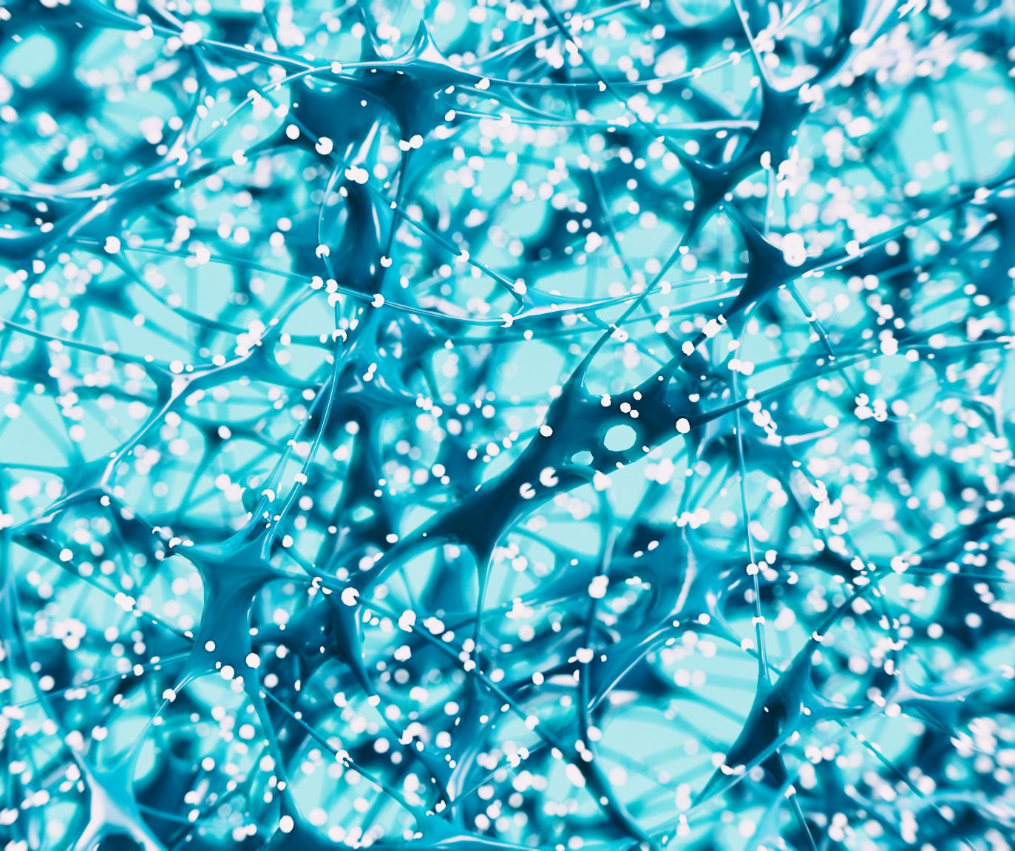
Purpose and Scope of the Survey
Comprehensive Literature Review
The survey synthesizes recent deep learning developments and identifies architectural innovations in 3D MRI super-resolution.
Reconstruction Mechanisms
It examines methods that convert low-resolution MRI slices into high-quality volumetric images using advanced algorithms.
Challenges and Solutions
The survey addresses computational complexity, data scarcity, and model generalization with proposed solution frameworks.
Future Research Guidance
The paper aims to guide development of efficient, adaptive, and clinically deployable 3D MRI super-resolution models.
Notes:
--- This slide references information from the following file: https://pwc-my.sharepoint.com/personal/manivasagan_n_pwc_com/_layouts/15/Doc.aspx?sourcedoc=%7BA6E83C66-E955-4155-ABE9-45936D13C444%7D&file=MANIVASAGAN%20-surveypaper-Final%20copy%20-%20Copy.docx&action=default&mobileredirect=true The survey provides a comprehensive review of deep learning-based super-resolution techniques for 3D MRI reconstruction. It synthesizes insights from recent literature, highlighting major developments, architectural innovations, and persistent research gaps. The paper explores fundamental principles of MRI SR, evaluates state-of-the-art deep learning strategies, and examines reconstruction mechanisms that transform low-resolution slices into high-quality volumetric images. Additionally, it reviews commonly used datasets and experimental protocols, proposing a generalized solution framework to address challenges such as computational complexity, data scarcity, and model generalization. The ultimate goal is to guide future research toward efficient, adaptive, and clinically deployable SR models for 3D MRI imaging.

Slide 5
Deep Learning Approaches for MRI Super-Resolution
Notes:
--- This slide references information from the following file: https://pwc-my.sharepoint.com/personal/manivasagan_n_pwc_com/_layouts/15/Doc.aspx?sourcedoc=%7BA6E83C66-E955-4155-ABE9-45936D13C444%7D&file=MANIVASAGAN%20-surveypaper-Final%20copy%20-%20Copy.docx&action=default&mobileredirect=true Key Techniques and Architectures, Comparative Analysis of Methods

Slide 6
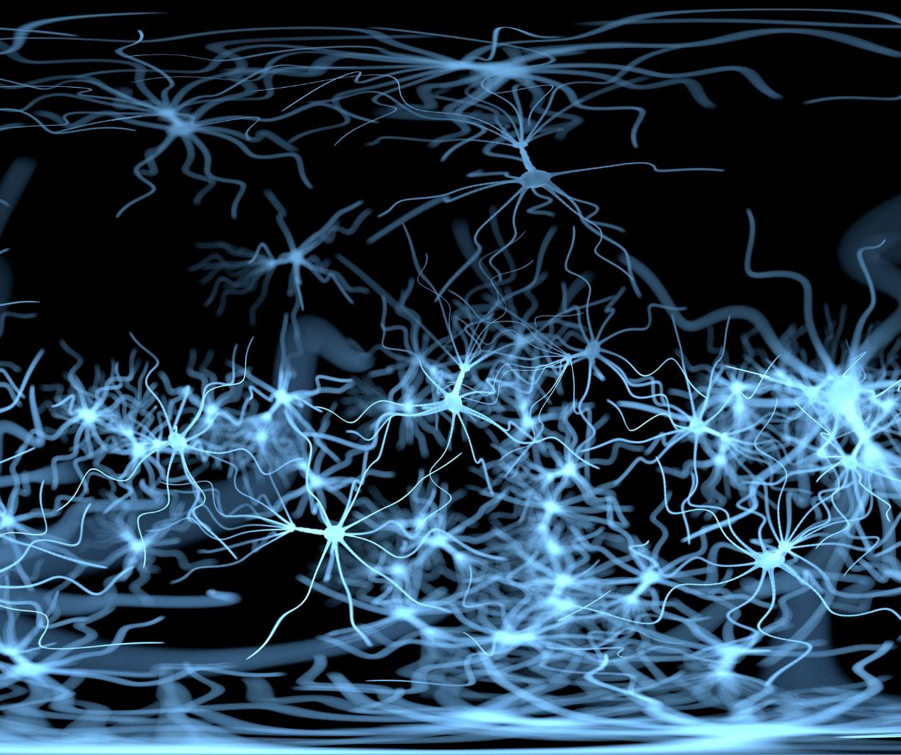
Key Techniques and Architectures
Convolutional Neural Networks
CNNs capture hierarchical spatial features and reduce noise in MRI images for improved super-resolution results.
Generative Adversarial Networks
GANs use adversarial training to enhance image realism and produce sharper, anatomically accurate reconstructions.
Transformer-based Models
Transformers utilize attention mechanisms to capture global context and maintain consistency across MRI slices.
Diffusion Models
Diffusion models progressively refine low-resolution inputs into high-fidelity volumetric MRI outputs via iterative denoising.
Notes:
--- This slide references information from the following file: https://pwc-my.sharepoint.com/personal/manivasagan_n_pwc_com/_layouts/15/Doc.aspx?sourcedoc=%7BA6E83C66-E955-4155-ABE9-45936D13C444%7D&file=MANIVASAGAN%20-surveypaper-Final%20copy%20-%20Copy.docx&action=default&mobileredirect=true Deep learning has revolutionized MRI super-resolution by enabling models to learn complex mappings between low-resolution and high-resolution images directly from data. Convolutional Neural Networks (CNNs) form the foundation of many SR frameworks, capturing hierarchical spatial features and reducing noise. Generative Adversarial Networks (GANs) further enhance image realism by employing adversarial training, which encourages sharper and more anatomically accurate reconstructions. Transformer-based models leverage attention mechanisms to capture global context and long-range dependencies, ensuring consistency across slices. Diffusion models introduce iterative denoising processes that progressively refine low-resolution inputs into high-fidelity volumetric outputs. These architectures outperform traditional methods by preserving fine anatomical details, improving signal-to-noise ratio, and supporting multi-modal integration for comprehensive diagnostic interpretation.

Slide 7
Comparative Analysis of Methods
Method | Metrics | Merits | Demerits
DVF-Net | DSC, vessel localization | Real-time reconstruction, motion tracking | Limited to liver data
NC-PDNet | PSNR, SSIM | Handles spiral/radial trajectories | High computational cost
ESRGAN | PSNR, SSIM | Improves 2D-to-3D detail recovery | Smoothing artifacts
SwinMR | PSNR, SSIM | Captures global context | Memory-intensive
Notes:
--- This slide references information from the following file: https://pwc-my.sharepoint.com/personal/manivasagan_n_pwc_com/_layouts/15/Doc.aspx?sourcedoc=%7BA6E83C66-E955-4155-ABE9-45936D13C444%7D&file=MANIVASAGAN%20-surveypaper-Final%20copy%20-%20Copy.docx&action=default&mobileredirect=true The survey compares leading deep learning models such as DVF-Net, NC-PDNet, MRSR-CNN, ESRGAN, CNet, miSRGAN, k-GAN, ULF-Net, InverseSR, MADGAN, DeepCSR, NeSVoR, and SwinMR. Evaluation metrics include PSNR, SSIM, DSC, MSE, and AUC, which consistently demonstrate the superiority of these models over conventional approaches. For instance, DVF-Net enables real-time 3D MRI reconstruction with motion tracking, while NC-PDNet excels in handling non-Cartesian trajectories. GAN-based models like ESRGAN and miSRGAN improve perceptual quality and structural fidelity, whereas transformer-based architectures such as SwinMR capture global contextual features for enhanced image sharpness. Despite these advancements, challenges remain in computational efficiency, scalability, and generalization across diverse imaging protocols.

Slide 8
Datasets and Experimental Protocols
Notes:
--- This slide references information from the following file: https://pwc-my.sharepoint.com/personal/manivasagan_n_pwc_com/_layouts/15/Doc.aspx?sourcedoc=%7BA6E83C66-E955-4155-ABE9-45936D13C444%7D&file=MANIVASAGAN%20-surveypaper-Final%20copy%20-%20Copy.docx&action=default&mobileredirect=true Overview of Popular Datasets

Slide 9
Overview of Popular Datasets
Dataset | Subjects | Modalities | Resolution | Usage
IXI | ~600 | T1, T2, PD | ~1 mm³ | Volumetric SR
fastMRI | ~1500 | T1, T2 | Raw k-space + 3D | Accelerated MRI
BraTS | ~450 | T1, T1c, T2, FLAIR | 3D multi-contrast | Tumor segmentation
ADNI | ~1000+ | T1, T2, FLAIR | High-resolution | Alzheimer’s research
HCP | ~1200 | T1, T2, diffusion | 0.7–1.25 mm³ | Connectivity mapping
Notes:
--- This slide references information from the following file: https://pwc-my.sharepoint.com/personal/manivasagan_n_pwc_com/_layouts/15/Doc.aspx?sourcedoc=%7BA6E83C66-E955-4155-ABE9-45936D13C444%7D&file=MANIVASAGAN%20-surveypaper-Final%20copy%20-%20Copy.docx&action=default&mobileredirect=true Several publicly available datasets support research in 3D MRI reconstruction and super-resolution. The IXI dataset includes T1-, T2-, and PD-weighted scans of over 600 healthy subjects, commonly used for volumetric reconstruction and multi-contrast analysis. The fastMRI dataset, developed by Facebook AI and NYU Langone Health, offers raw k-space data and fully reconstructed images for accelerated MRI research, with approximately 1,500 brain scans. BraTS focuses on glioma patients, providing multi-contrast MRI and voxel-level tumor annotations for segmentation tasks. ADNI offers longitudinal scans for Alzheimer’s research, while the Human Connectome Project (HCP) provides high-resolution structural and diffusion MRI volumes for connectivity mapping. These datasets enable robust model training and evaluation across diverse anatomical and pathological conditions.

Slide 10
Key Findings and Strategic Insights
Notes:
--- This slide references information from the following file: https://pwc-my.sharepoint.com/personal/manivasagan_n_pwc_com/_layouts/15/Doc.aspx?sourcedoc=%7BA6E83C66-E955-4155-ABE9-45936D13C444%7D&file=MANIVASAGAN%20-surveypaper-Final%20copy%20-%20Copy.docx&action=default&mobileredirect=true Research Trends and Future Directions

Slide 11
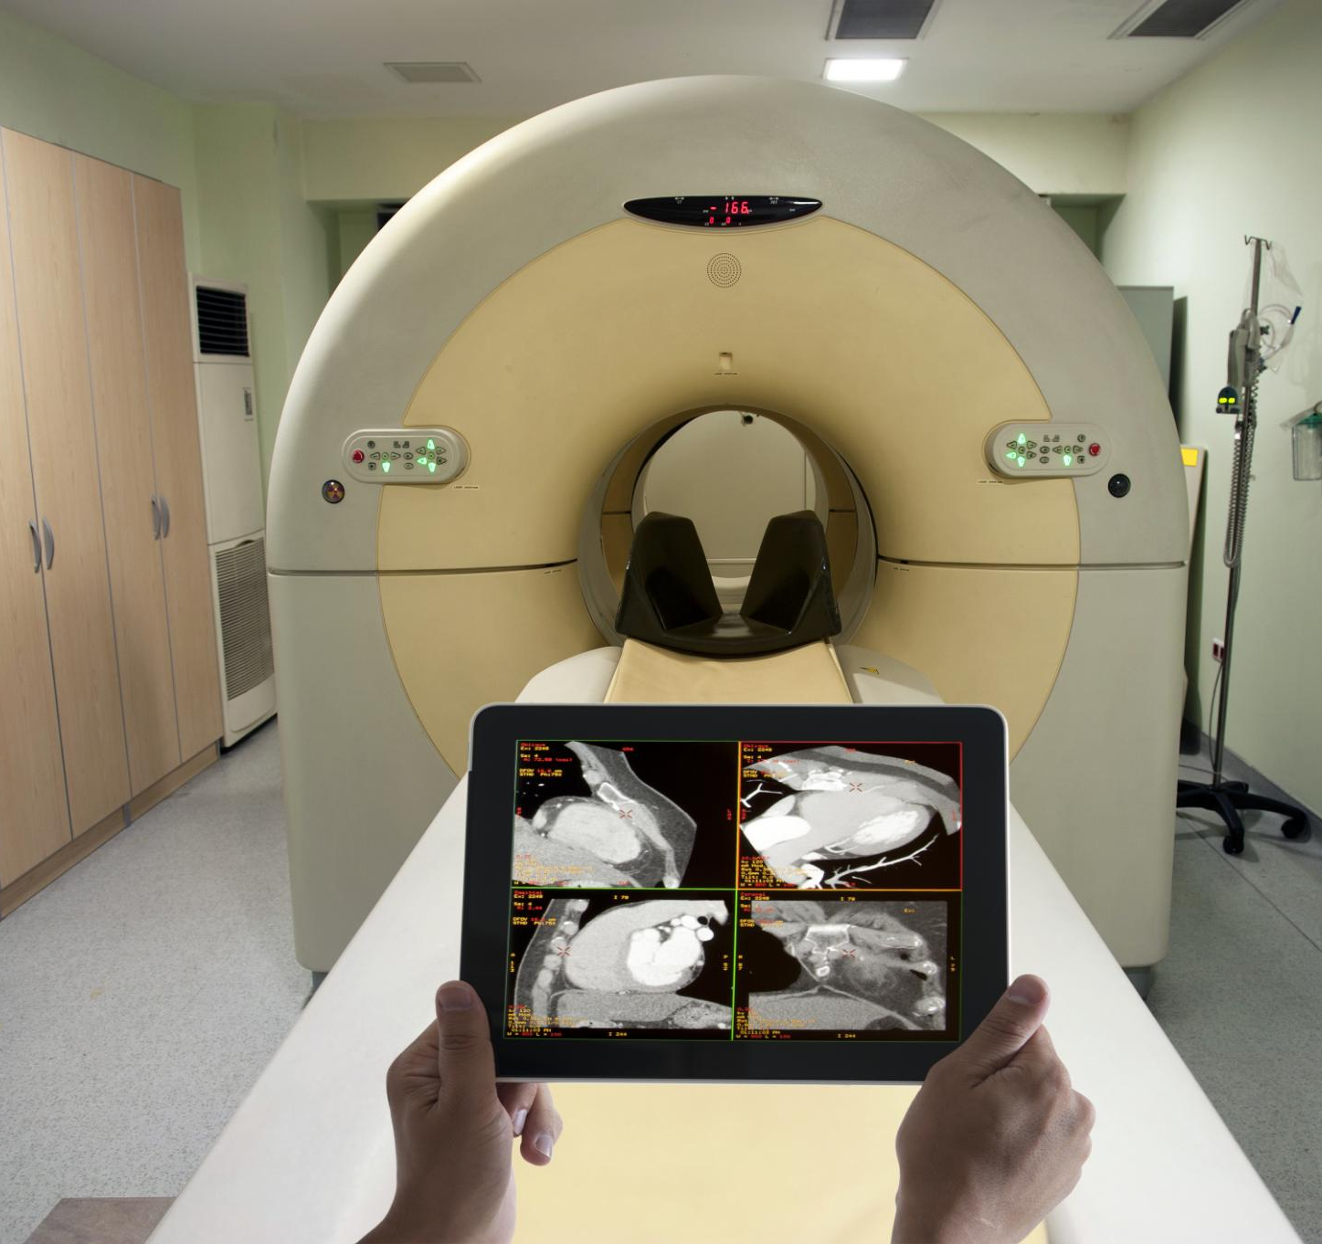
Research Trends and Future Directions
Deep Learning Advancements
Deep learning methods enhance 3D MRI reconstruction by recovering high-quality images from sparse data efficiently.
Hybrid and Multi-modal Approaches
Combining physics-based constraints with deep learning and multi-modal fusion improves image fidelity and diagnostic accuracy.
Emerging Models and Architectures
Generative models and transformers provide realistic volumetric outputs and capture global context in MRI data.
Future Research Focus
Future work should improve computational efficiency, generalizability, interpretability, and enable real-time clinical deployment.
Notes:
--- This slide references information from the following file: https://pwc-my.sharepoint.com/personal/manivasagan_n_pwc_com/_layouts/15/Doc.aspx?sourcedoc=%7BA6E83C66-E955-4155-ABE9-45936D13C444%7D&file=MANIVASAGAN%20-surveypaper-Final%20copy%20-%20Copy.docx&action=default&mobileredirect=true The survey highlights a clear trend toward deep learning-based methodologies for 3D MRI reconstruction due to their superior ability to recover high-quality images from sparse or undersampled data. Hybrid strategies combining physics-based constraints with deep learning have improved structural fidelity and data consistency. Multi-modal fusion approaches leveraging complementary information from different MRI sequences enhance perceptual quality and diagnostic accuracy. Generative and diffusion-based models offer promising avenues for realistic volumetric outputs, while transformer architectures excel in capturing global context. Future research should focus on addressing computational challenges, improving generalization across scanners, and integrating interpretability for clinical validation. Real-time processing and scalable deployment remain critical for translating these advancements into routine clinical practice.

Slide 12
Conclusion and Recommendations
Notes:
--- This slide references information from the following file: https://pwc-my.sharepoint.com/personal/manivasagan_n_pwc_com/_layouts/15/Doc.aspx?sourcedoc=%7BA6E83C66-E955-4155-ABE9-45936D13C444%7D&file=MANIVASAGAN%20-surveypaper-Final%20copy%20-%20Copy.docx&action=default&mobileredirect=true Summary and Actionable Insights

Slide 13
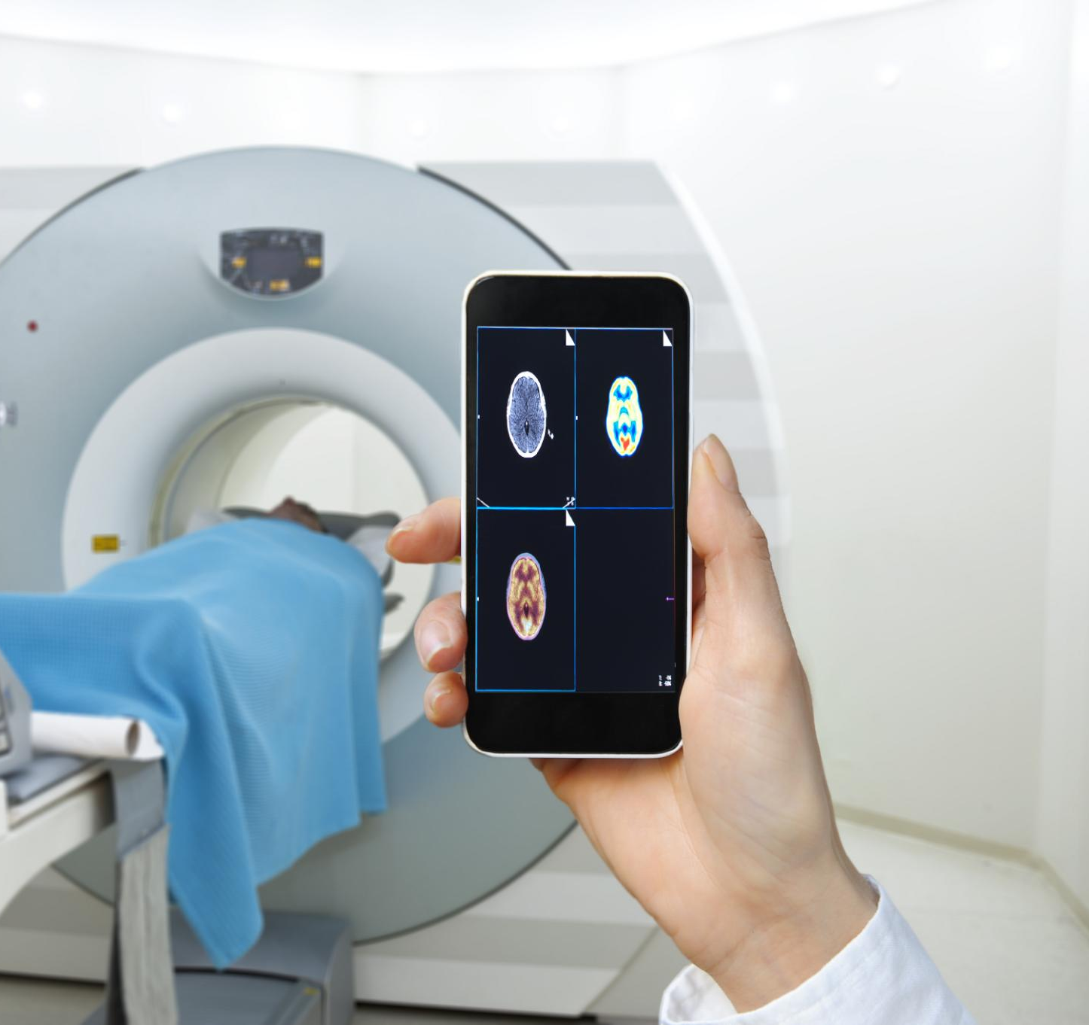
Summary and Actionable Insights
Super-Resolution in MRI
Deep learning super-resolution enables fast, high-quality 3D MRI reconstruction without extra scan time, improving diagnostics.
Model Development Priorities
Focus on adaptive, clinically validated models that integrate multi-modal data and handle large-scale datasets efficiently.
Performance Optimization
Optimize computational speed for real-time applications ensuring robustness across various imaging protocols.
Collaborative Adoption
Encourage partnerships between academia, industry, and healthcare to accelerate clinical integration of these technologies.
Notes:
--- This slide references information from the following file: https://pwc-my.sharepoint.com/personal/manivasagan_n_pwc_com/_layouts/15/Doc.aspx?sourcedoc=%7BA6E83C66-E955-4155-ABE9-45936D13C444%7D&file=MANIVASAGAN%20-surveypaper-Final%20copy%20-%20Copy.docx&action=default&mobileredirect=true Deep learning-based super-resolution techniques are transforming MRI diagnostics by enabling high-quality, rapid 3D reconstruction without additional scanning time. These methods improve diagnostic accuracy, reduce patient discomfort, and enhance clinical workflow efficiency. To maximize impact, researchers and practitioners should prioritize developing adaptive, clinically validated models that integrate multi-modal data and operate efficiently on large-scale datasets. Emphasis should be placed on optimizing computational performance for real-time applications and ensuring robustness across diverse imaging protocols. Collaborative efforts between academia, industry, and healthcare institutions will be essential to accelerate the adoption of these technologies in clinical settings.

